Slide 1
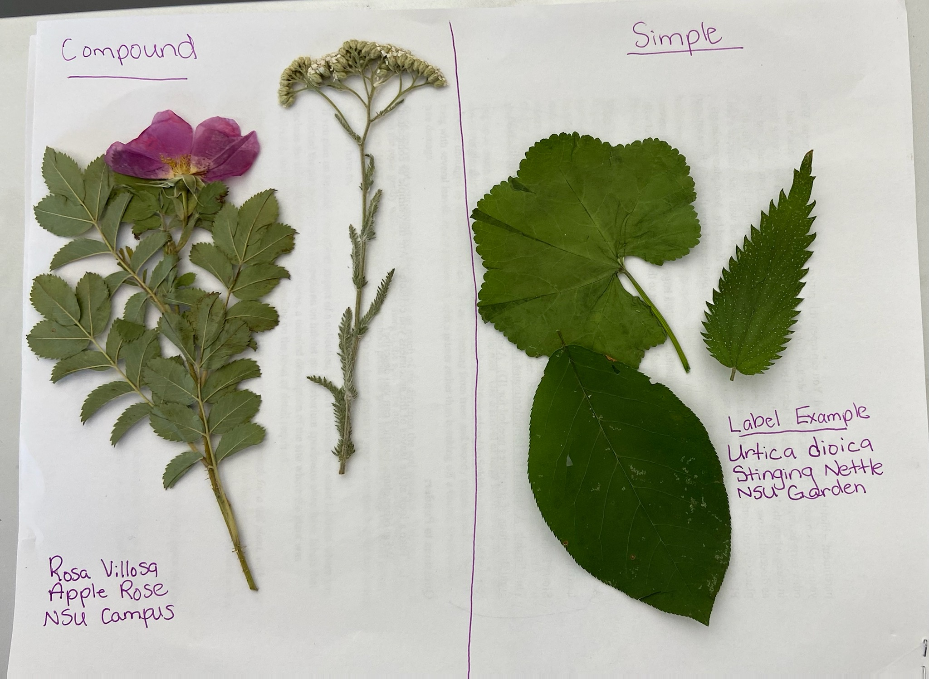
Plant Studies
NSU STEM Kits
Notes:
Total signage budget you are asking for.

Slide 2
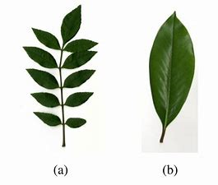
Background Information
How to identify types of leaves (see video):
-Compound (A) – consists of many leaflets attached to a stem
-Simple Leaf (B) – consists of a single, undivided leaf
(1) Simple and compound leaves - YouTube
Notes:
What is included

Slide 3
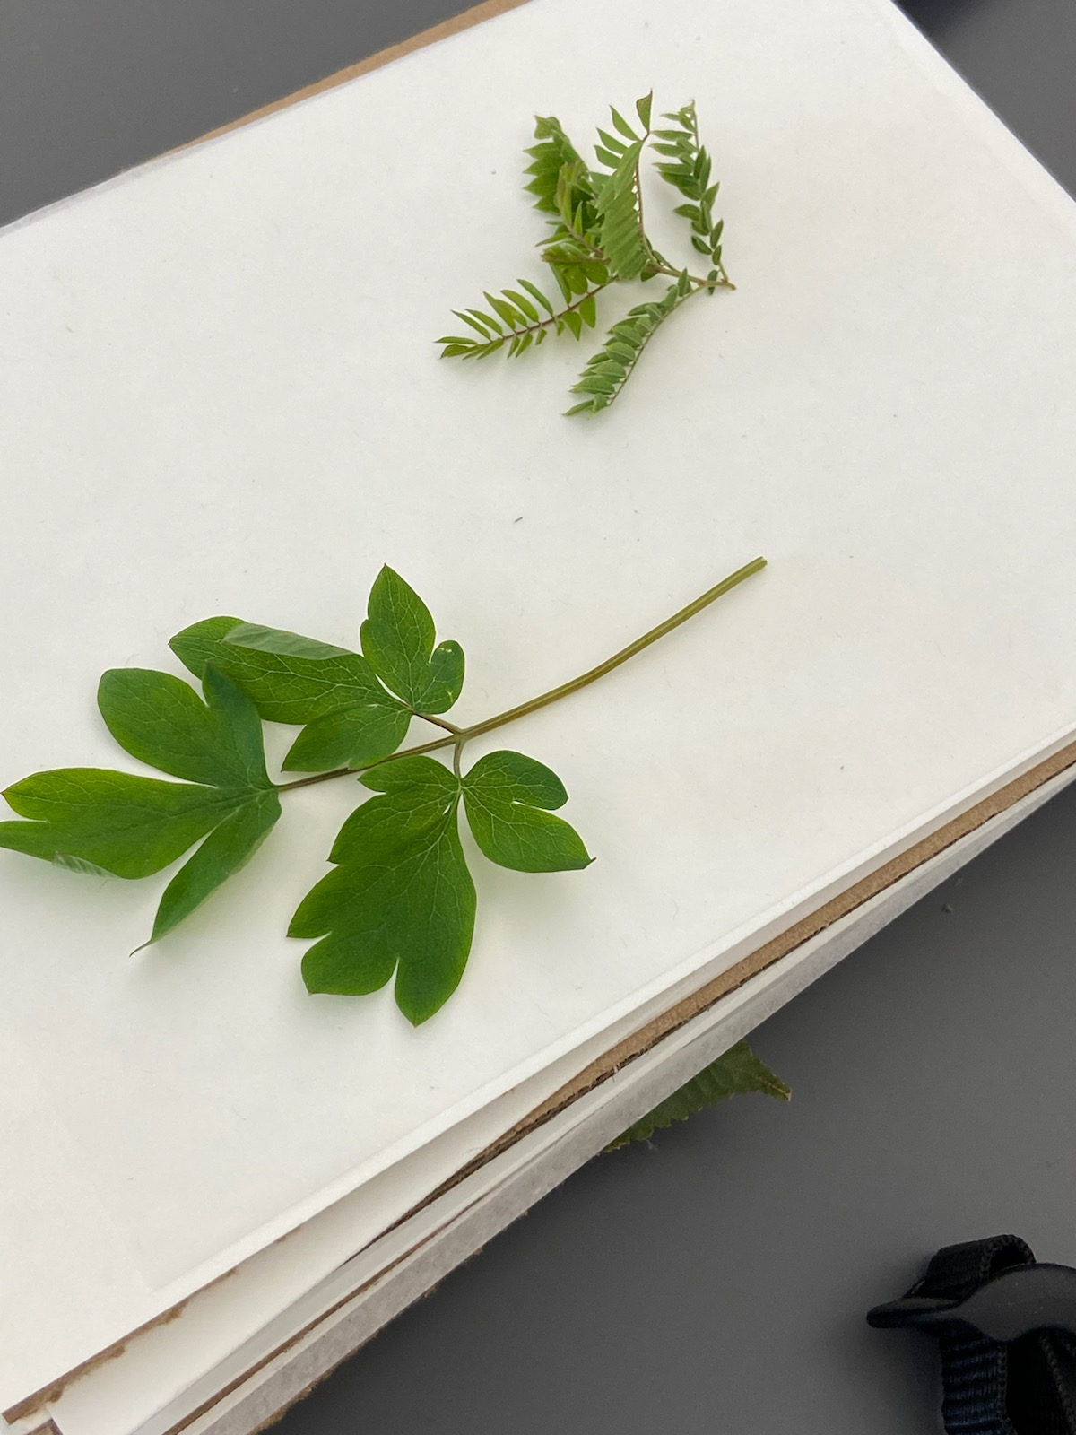
Collecting Specimen
How to properly collect specimens (See video):
Select specimens that are undamaged
Specimens with flowers, fruit and roots present may also be used
When using a tree, clip a twig with several leaves
Store in plastic bag with wet paper towel
Press specimens as soon as possible
(1) Using A Plant Press - YouTube

Slide 4
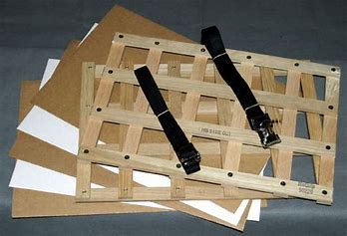
Procedure
Collect materials and assemble them for your plant press. This includes plant press boards, cardboard sheets, blotting paper, and parchment paper.
Collect your specimens as per the prior slide. Be sure to note when collecting scientific name, common name, and details about the collection site. A plant identification app such as Seek, or Plant Identifier is helpful with identification.
Notes:
What is included

Slide 5
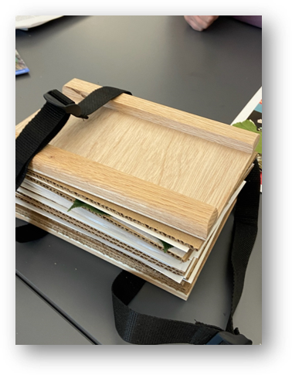
Procedure
Press your specimens using your plant press as soon as possible. Between your press board you should have cardboard, blotting paper (thicker white paper), parchment, specimen, parchment, blotting, and cardboard in that order.
Let dry for several days in a warm dry place. The longer you let dry, the better the plant press will work.

Slide 6
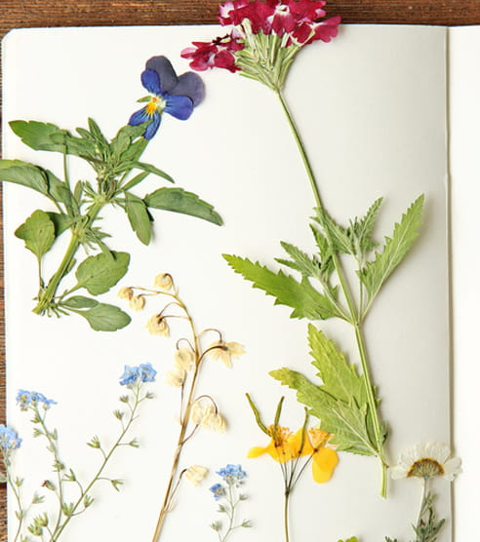
Procedure
When dry, remove the plants from the press and store in newspaper until you are ready to take home or mount on herbarium paper.
To mount, use clear glue and secure as much of the plant to paper as possible. Add a label with information outlined above and any extra information the teacher wants students to identify (ex: compound vs. simple).

Slide 7
Safety Information
Use gloves to prevent skin reactions.
Be sure you have permission to take samples from the areas you are choosing.
Ensure you’re not picking an endangered species.
Do not pick poisonous plants!
Notes:
What is included

Slide 8
Extra Information
Teacher’s note: you may need a week between collection and pressing flowers until they are dried out.
Websites:
https://biodiversity.utexas.edu/news/entry/leaves
https://imom.com/printable/leaf-identification-game/
Standards Covered:
3rd Grade Standards: 3-LS1-1 and 3-LS3-1
4th Grade Standard: 4-LS1-1
5th Grade Standards: 5-PS1-3 and 5-LS1-1
Notes:
What is included

Slide 9
Questions
How did you decide if a leaf was simple or compound?
What other characteristics/observations do you have for your specimens?
What did you find challenging in this exercise? How did this challenge help you learn?
How does the structure of the leaves help the plant gather what it needs for survival?
Notes:
What is included

Slide 10
Science Standards Covered
Organizing science information.
Developing science writing skills.
Mapping and visualizing data.

