Slide 1
Solder a Badge!
NSU STEM Kits
Notes:
Total signage budget you are asking for.

Slide 2
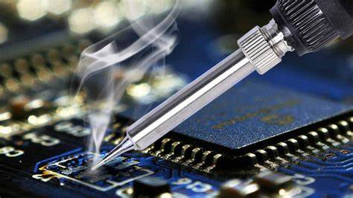
Why Learn to Solder?
Soldering is the process of joining together two metal items by applying solder to the joint.
It is a fundamental skill in electrical engineering.
Allows people to repair or build electronic devices.
Gain an understanding of electrical design. AdaFruit’s

Slide 3
Background and Resources
’Colin’s Lab: Soldering’ video tutorial
Sparkfun’s ‘How to Solder’
Soldering for kids: A brief tutorial for Parents and Teachers

Slide 4
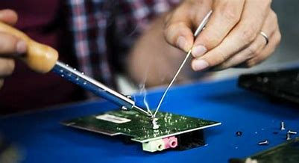
Advice on Technique:
Heating up the board is as important as heating up the soldering wire.
Don’t leave the soldering iron on the board for more than 3 seconds.
Work in the following order: Heat Solder Solder Heat

Slide 5
Safety!
Work in a clear, clutter free workspace
Wear eye protection
Never touch the element or tip of the soldering iron – it is hot (over around 350°C)!
Never touch the soldering iron to anything that is plugged in or has live wires
Always use a soldering iron stand
Age of class? (Maybe better for 5th grade kids versus 3rd grade kids)
If you have any younger siblings, make sure they are not able to get the battery. It should never go in someone’s mouth!

Slide 6
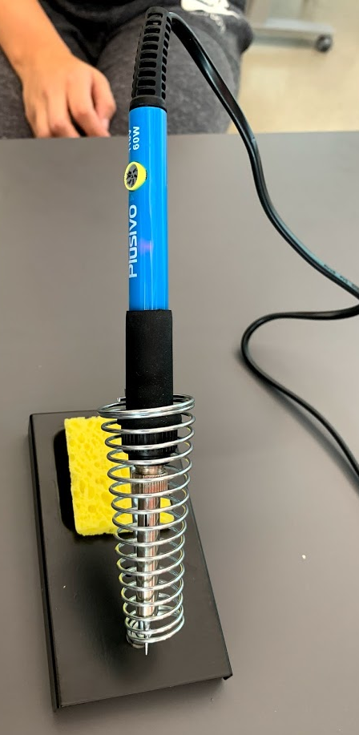
Materials Needed
2 LED lights of the same color
CR2032 battery
Soldering wire
Soldering iron and stand
Wet sponge
The badge with pin
Battery holder
Notes:
What is included

Slide 7
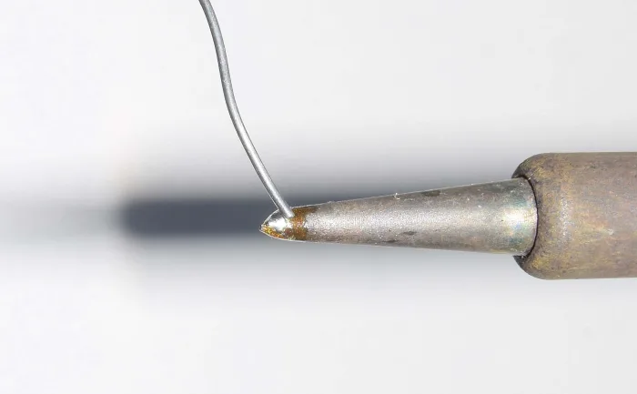
Procedure
Test your battery and LED bulbs.
Wet and ring out your sponge.
Plug in the iron, set the temperature at 350°C and wait a few minutes for it to heat up.
Clean the tip on the sponge, giving it a brief wipe.
Hold the solder wire in one hand and the iron in the other. Touch the end of the wire on both sides of the tip and allow it to flow. If a blob forms on the end, wipe it off on the sponge.
Notes:
What is included

Slide 8
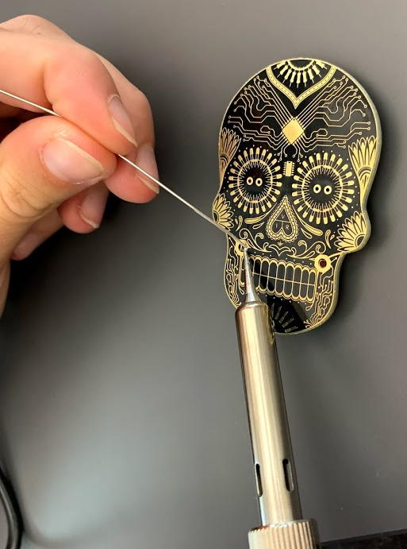
Attach the battery holder on the back and let the legs come through the holes.
Hold the tinned tip of the soldering iron against the leg that comes through the hole.
Then, place the wire against the leg and it will melt the wire.
Solder all around the leg so it is attached to the badge.
Procedure

Slide 9
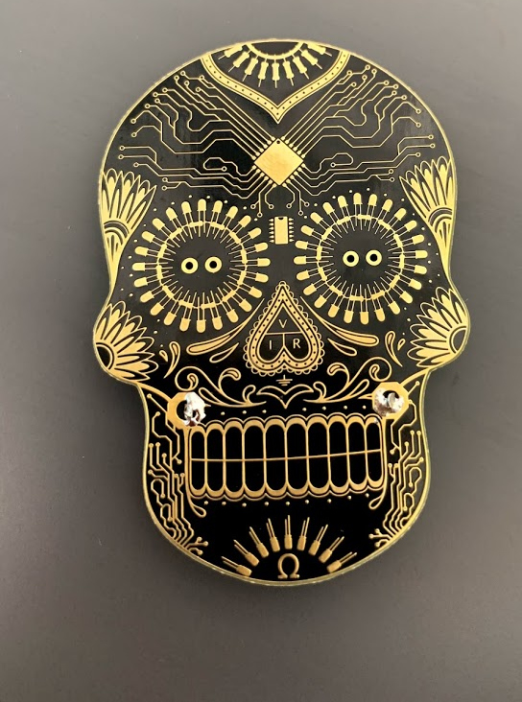
Procedure
The front of the badge should look like this. Make sure that the battery holder is attached well and will not fall off.
Remember to wet the iron tip regularly to clean off excess wire.

Slide 10
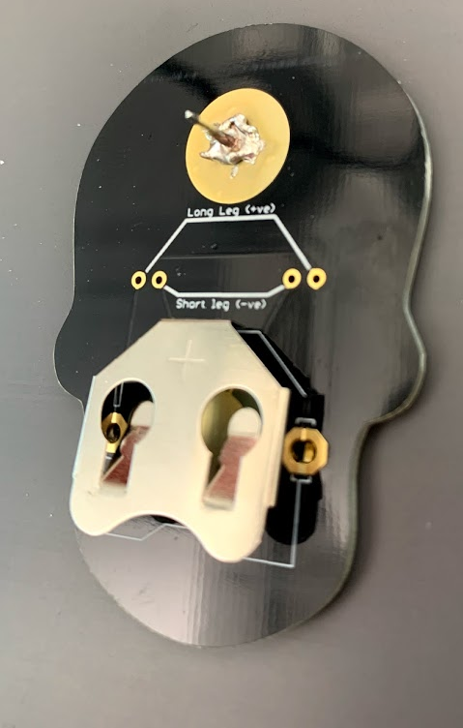
Place the pin on the golden circle on the back of the badge.
Hold the soldering iron on the pin and then touch the pin with the wire.
Solder all around the pin so it will stay on the badge.
This can be the trickiest part of this activity – be patient.
Procedure

Slide 11
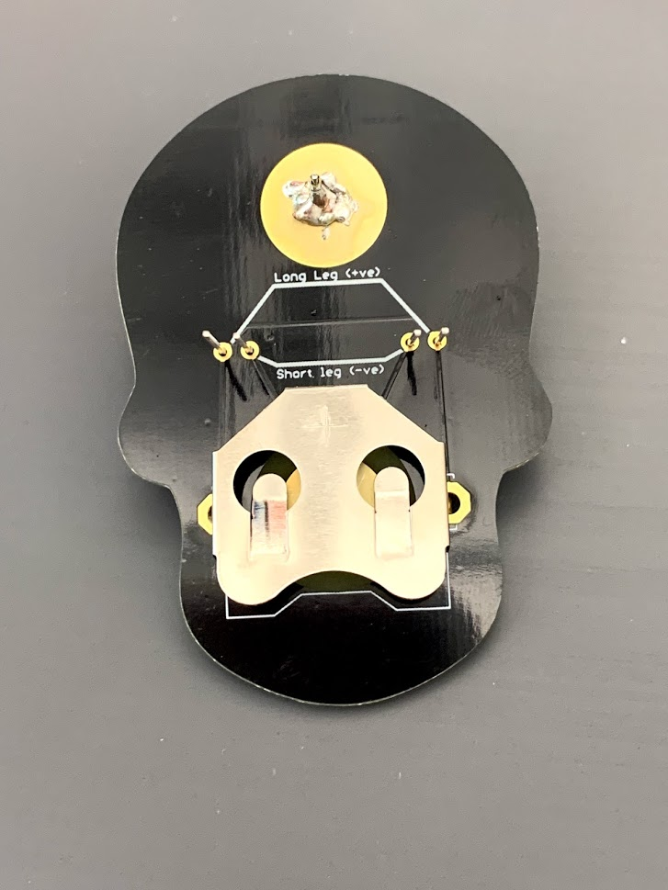
Take the LED lights and insert the legs into the holes, make sure that the short leg goes inside and the long leg outside.
Solder the leg on the badge by holding the soldering iron on the leg and then placing the wire on the leg, near the tip of the iron, to melt it.
All the gold around the legs should be covered.
Procedure

Slide 12
Procedure
Cut the excess off the legs.
Insert the battery and amaze your friends and family with your engineering prowess!

Slide 13
Quesitons
How did the lights light up?
Which profession do you think uses soldering the most?
Why may soldering be important in the real world?

Slide 14
Science Standards Covered
Building your scientific vocabulary.
Making connections between science and other subjects.
Strengthing knowledge of structure and function of tools.
Learned importance of lab/classroom safety.

