Slide 1
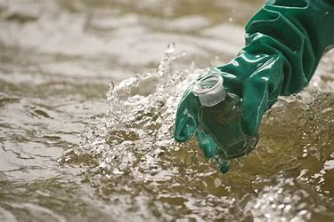
Water Quality Testing
NSU STEM Kits
Notes:
Total signage budget you are asking for.

Slide 3
Materials Needed For Each Pair of Students:
Plastic beaker
Water collection tubes
Nitrate and nitrite testing strips
Phosphate testing strips
pH testing strips
Water from tap
Water from a local body of water
Sharpie
Timer
Notes:
What is included

Slide 4
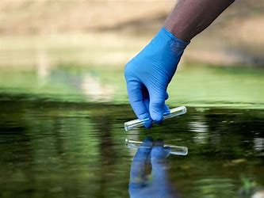
Safety
Situational awareness while outside collecting samples.

Slide 5
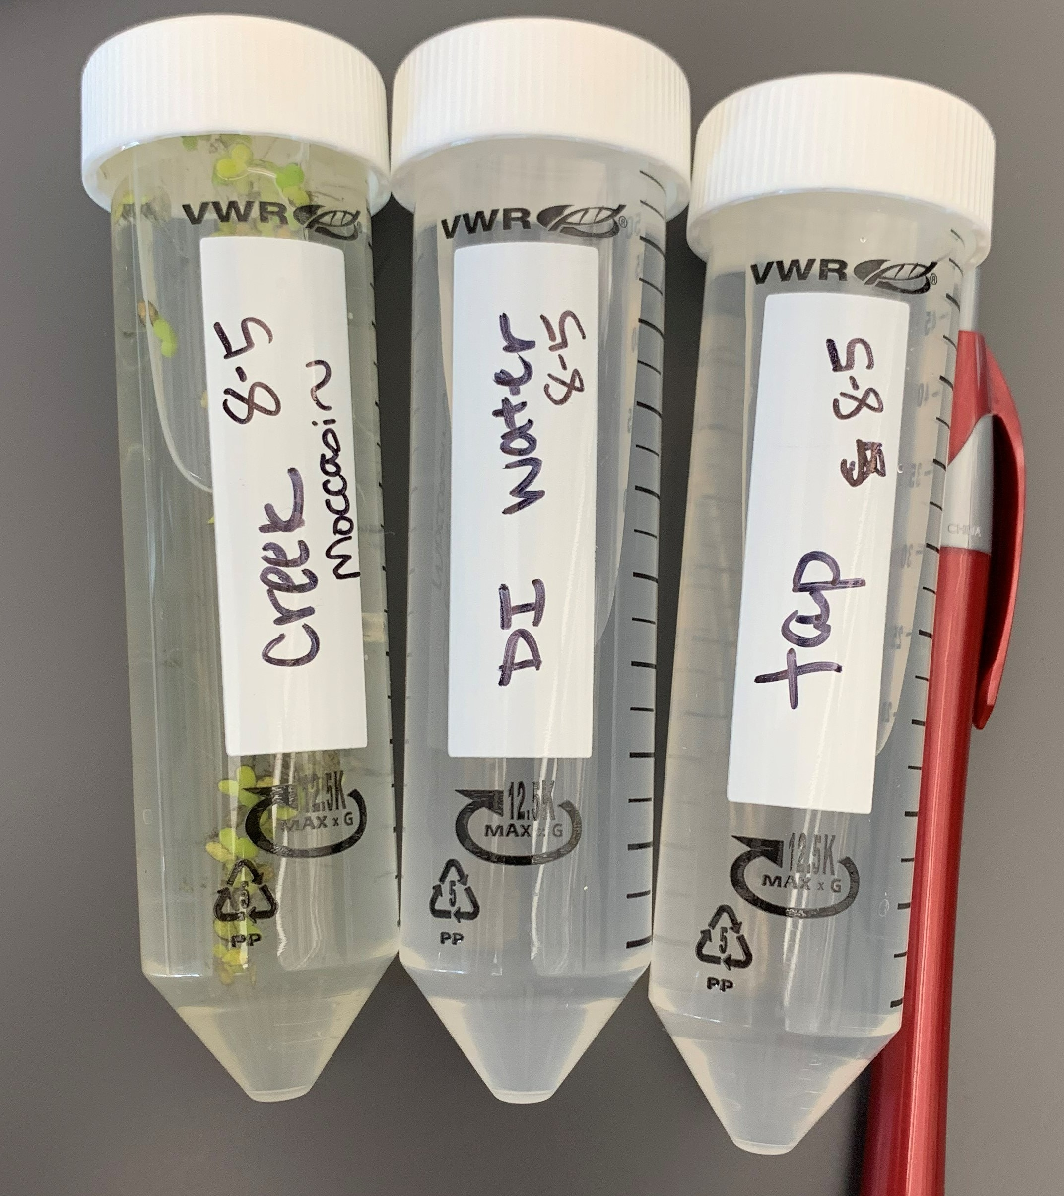
Procedure
Collect your water samples
Use your sharpie to label collection tubes, date collected, and specific location it was collected from.
~The outside sample should be labeled with the type of water body the sample was collected (lake, river, steam, puddle, etc.)
Bring samples back to the room for testing.
~You’ll be testing the water samples for nitrate and nitrite levels, phosphate levels, pH levels, and the presence of microorganisms, which you will look for under the microscope.
Before pouring your samples into beakers for testing, clearly label the beakers
with which water sample is in which beaker.
5) This can be done by labeling tape and placing the tape on the beaker
so that the beaker may be reused.
6) Once your beakers are labeled, pour your water samples into them.
Notes:
What is included

Slide 6
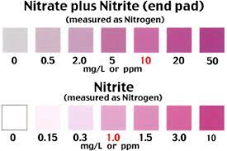
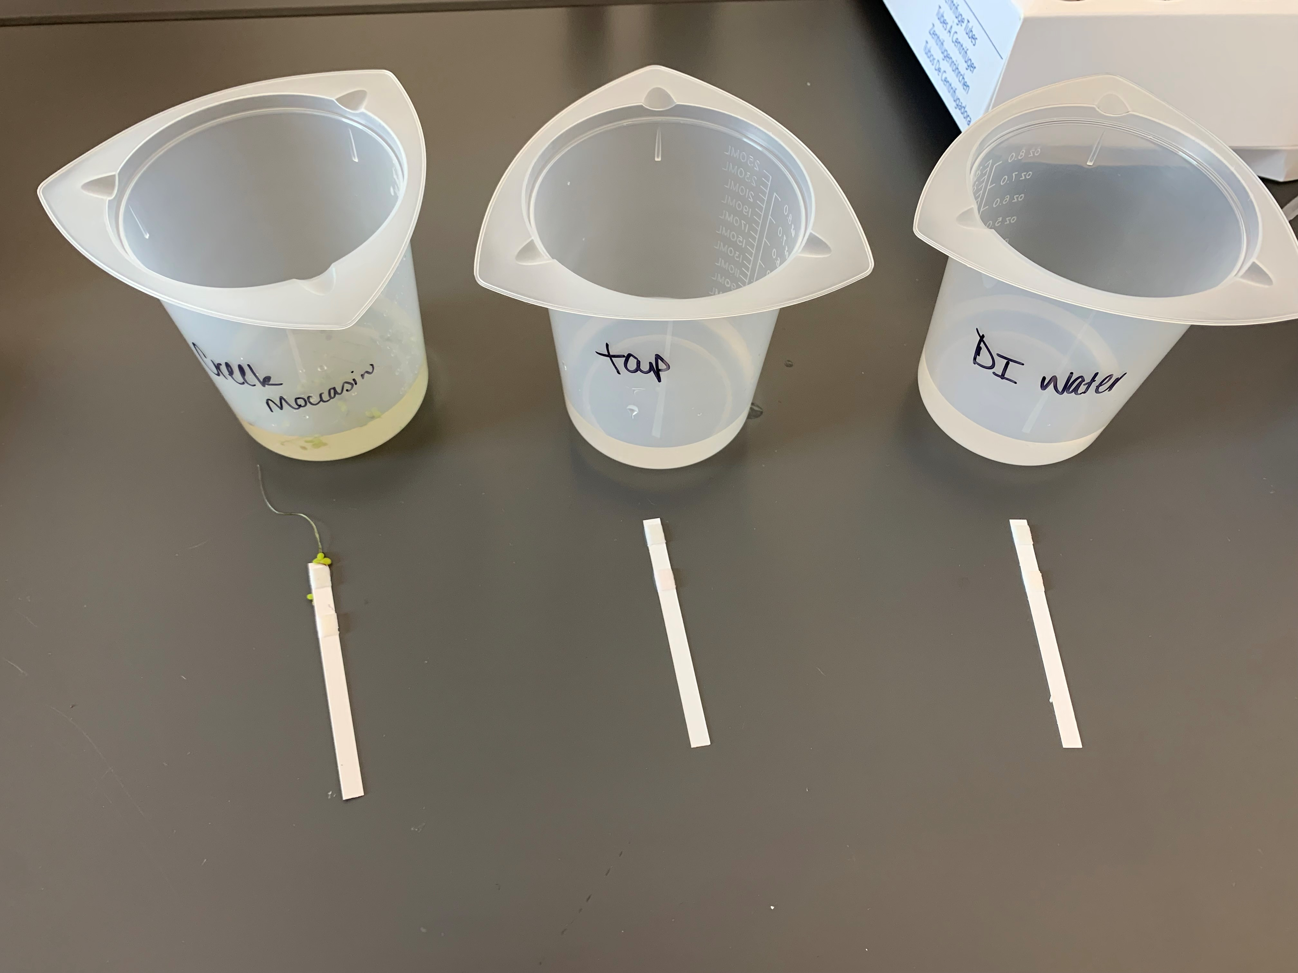
Nitrate and Nitrite Testing
Remove two test strips from the container, one for each water sample.
Dip the test strips into each water sample for two seconds and remove.
Wait one minute for results
After one minute, compare the color of the test strip to the colors on the bottle to determine the level of nitrate and nitrite in your water.
Determine if your samples have a good, fair, or poor quantity of nitrate and nitrites:
Good: Less than 5 ppm
Fair: 5-10 ppm
Poor: Greater than 10 ppm

Slide 7
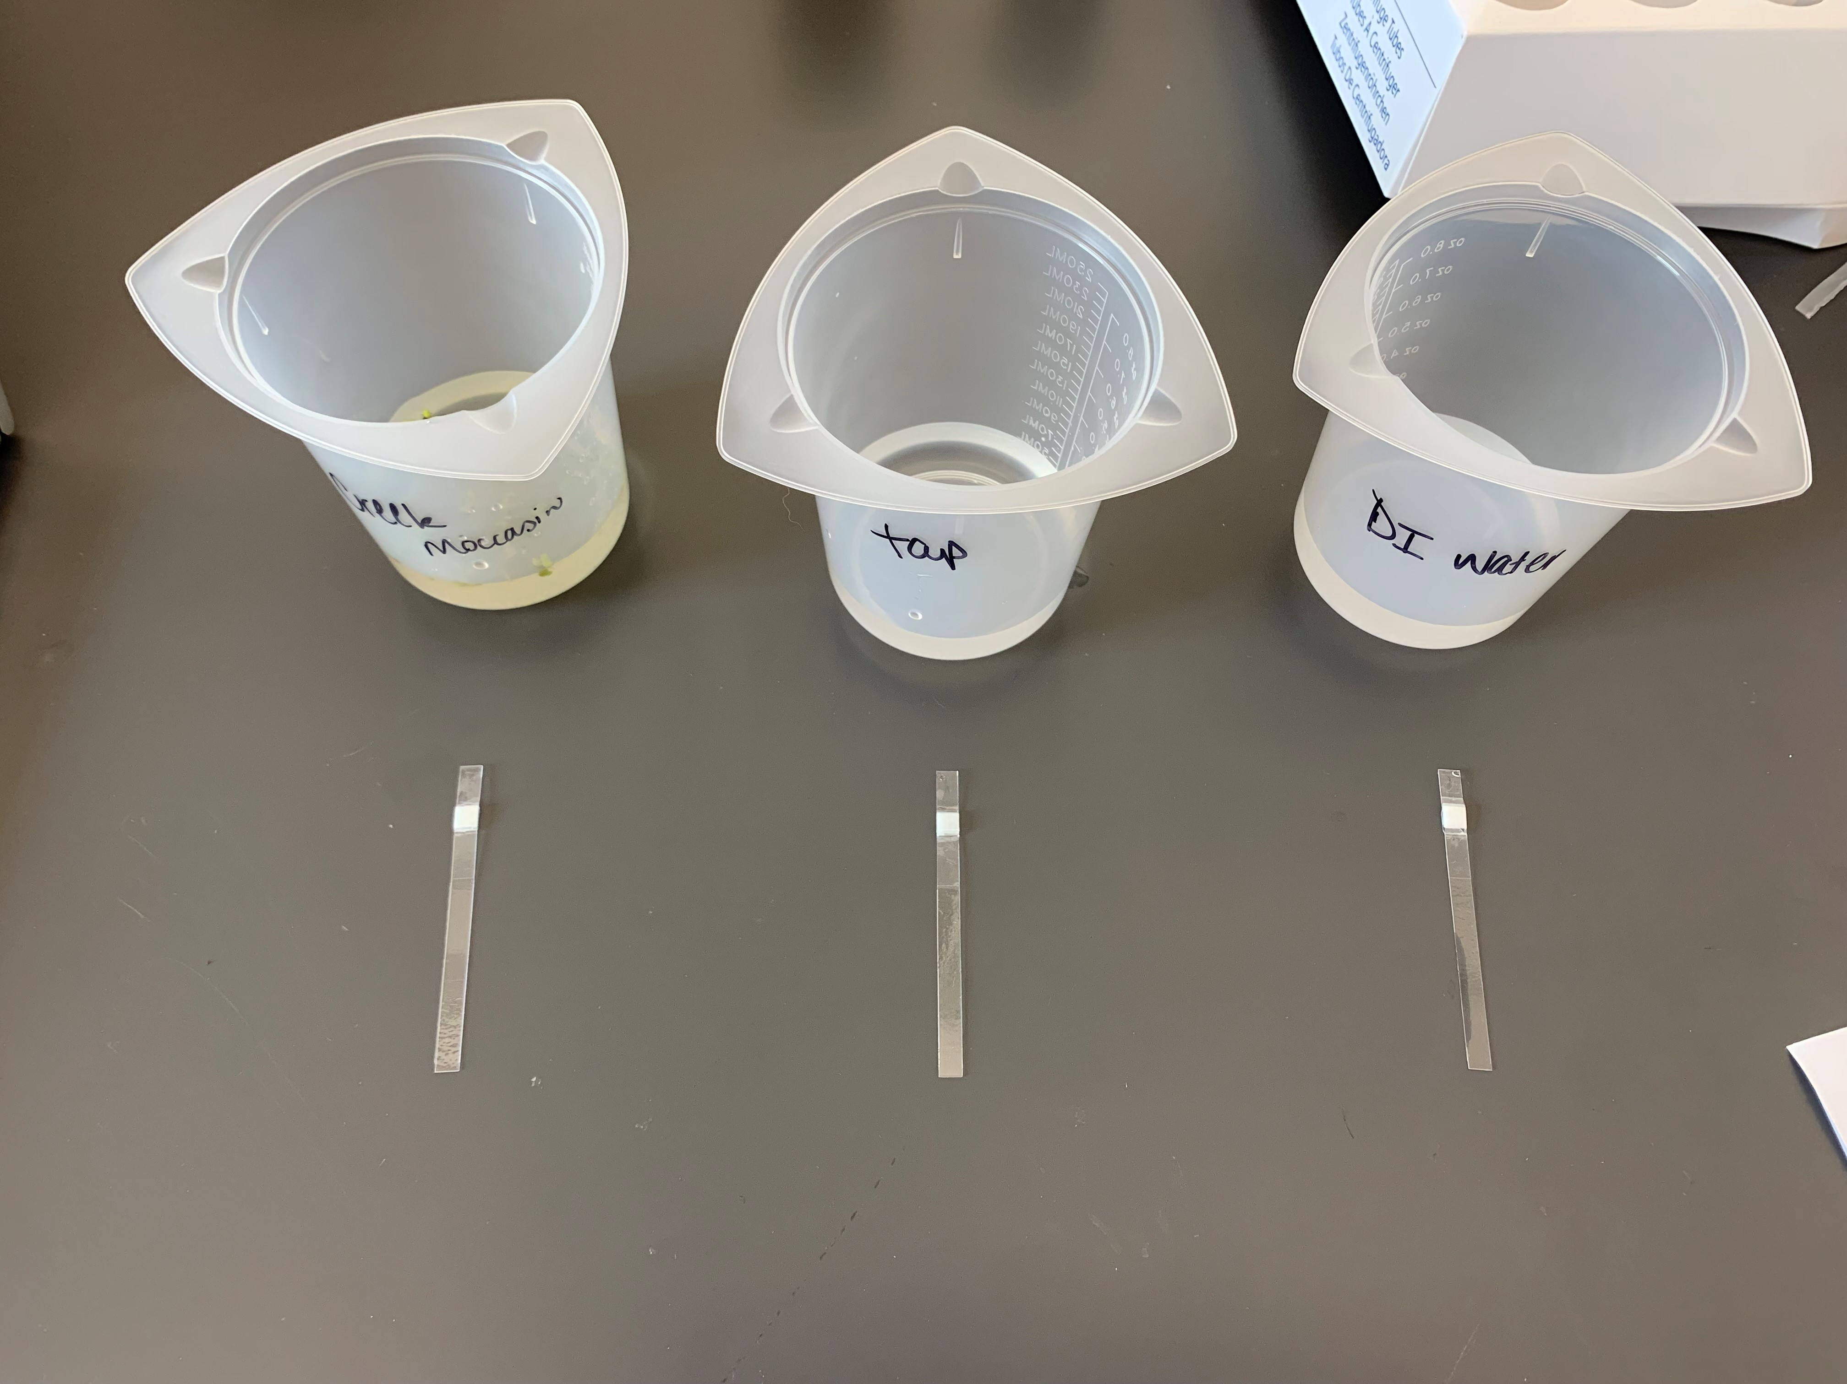
Phosphate Testing
Using the same water samples, remove two test strips from the container, one for each water sample.
Dip the test strips into each water sample for one second and remove.
Wait three minutes for results.
After three minutes, compare the color of the pad on the test strip to the colors on the bottle to determine the level of phosphate in your water.
Determine if your samples have a good, fair, or poor quantity of phosphate:
Good: The closer to zero the better
Fair: 10 ppm
Poor: Greater than 10 ppm

Slide 8
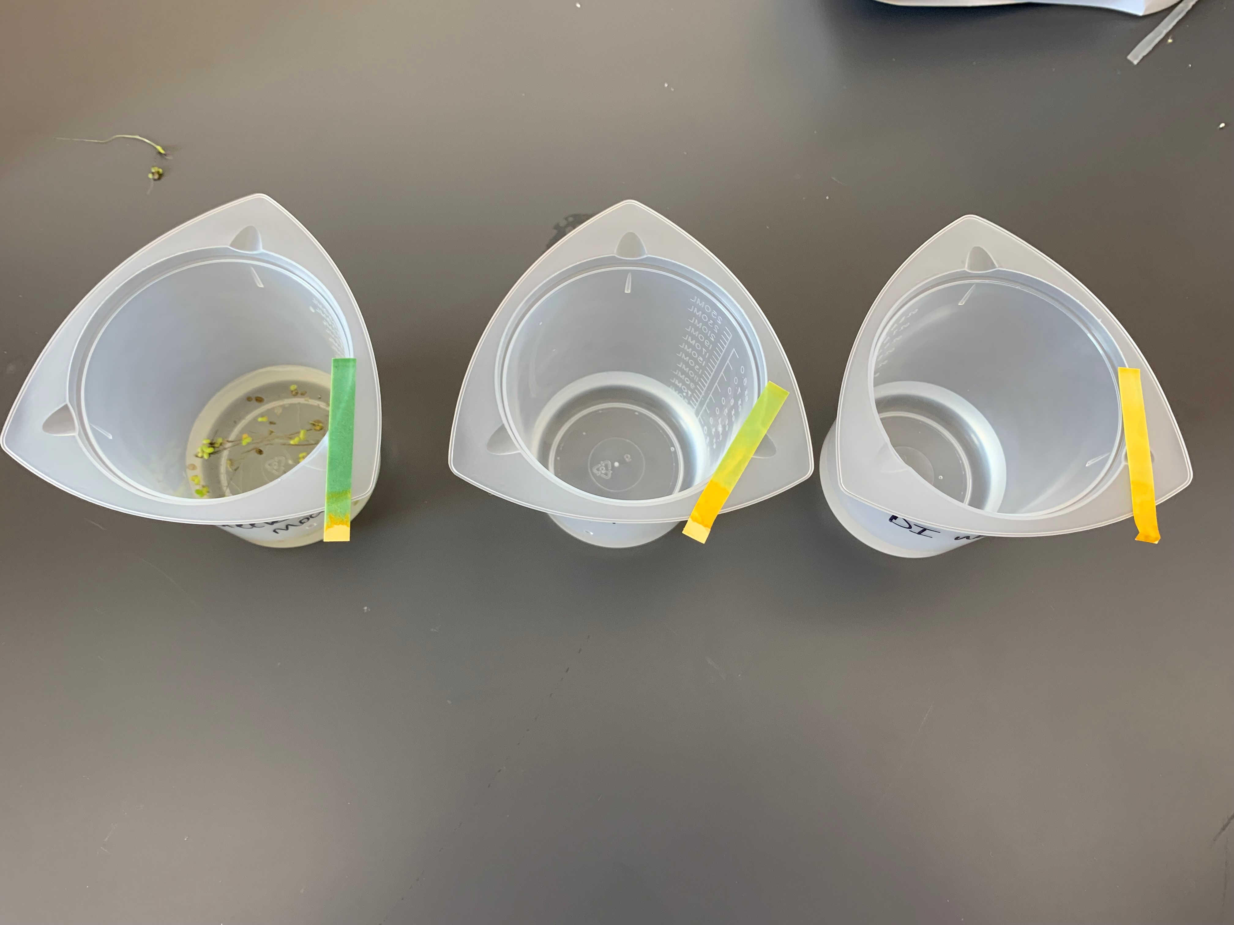
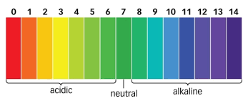
pH Testing
Using the same water samples, remove two test strips from the container, one for each water sample.
Dip the test strips into each water sample and remove immediately.
Compare the color on the strip to the color chart on the bottle.
Determine if your samples have a good, fair, or poor pH level:
Excellent: 7 (neutral)
Good: 6-8 range (6 is slightly acidic, 8 is slightly basic)
Poor: 0-5 (acidic) or 9-14 (basic)

Slide 9
Questions to Ponder
Which type of water is the best/healthiest?
What are some ways to prevent water pollution?

Slide 10
Science Standards Covered
Building a scientific vocabulary
Organizing science information
Visualizing data
Thinking Critically

